Slide 1
My Journey Through the Solar System
Name
Institution
Date

Slide 2
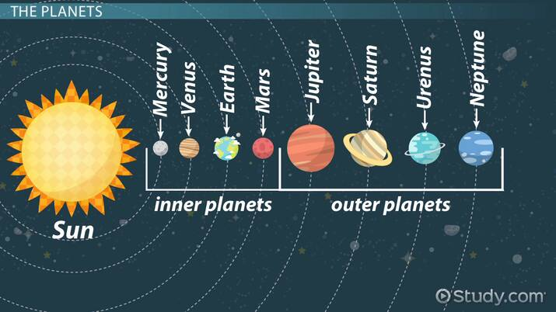
Introduction
The solar system is made up of the Sun and all the other things that orbit around it, especially the planets, moons, asteroids, and meteoroids (The Planets, 2019).
People have been committed to studying the solar system, but all that the Astronauts have known is very little as compared to what exists in the solar system.
The National Aeronautics and Space Administration (NASA) has been on the front line in conducting flight research and studying the faraway stars to make the Earth a better place.
NASA receives its primary finances from the United States government. However, funds are not sufficient to facilitate the intended research and, thus, increase funding (Milman, 2016).
The main focus of this presentation is to discuss the significance of increasing the fund to NASA to facilitates a deep understanding of specified planets in the solar system.
Notes:
The solar system is made up of the Sun and all the other things that orbit around it, especially the planets, moons, asteroids, and meteoroids. Human efforts and curiosity to understand the nature of the world we live in led to the discovery of the solar system. Astronauts have been committed to understanding the solar system and improving human knowledge on the solar system (Milman, 2016). The National Aeronautics and Space Administration (NASA) has been on the front line in conducting flight research and studying the faraway stars to make the Earth a better place. NASA was founded in 1958 by the American government, and the primary source of funds to this critical organization is the U.S government (The Planets, 2019). The Astronauts have discovered that there is a lot in the solar system that can help improve human lives. However, without sufficient finances, then all these cannot happen. Therefore, the main focus of this presentation is to discuss the significance of increasing the fund to NASA to facilitates a deep understanding of specified planets in the solar system.

Slide 3
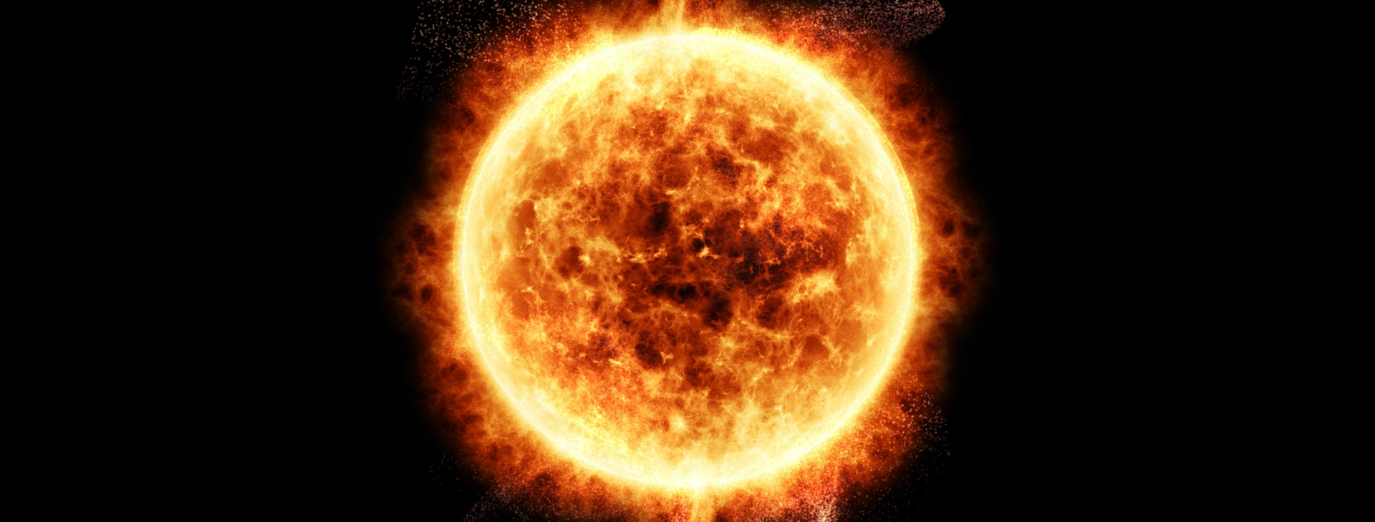
The Sun
The Sun is a celestial body because it is a natural body outside the Earth's surface. It is a huge glowing sphere of hot gas with hydrogen 70%, helium 28%, carbon, nitrogen, and oxygen, adding up to 1.5 % and 0.5% made of traces of neon, iron, sulfur, magnesium, and silicon (Jesus-Rydin et al., 2018).
The Sun has the following physical properties; Mass: 1.98892 x 1030 kg, Diameter: 1,391,000 kilometers, Radius: 695,500 km, Surface gravity of the Sun: 27.94 g, Volume of the Sun: 1.412 x 1018 km3 and Density of the Sun: 1.622 x 105 kg/m3.
The Sun is 151.75 million Kilometer away from the Earth.
The Sun was discovered at around 450 BC by Anaxagoras, but other scientists like Galilea Galileo discovered its physical properties.
The Sun is a unique celestial body as it resided at the center of the solar system, and it's the only star visible from the Earth using the naked eye.
Notes:
A celestial body is a natural body outside the Earth's surface. The Sun is an astronomical body made of a vast glowing sphere of hot gas with hydrogen 70%, helium 28%, carbon, nitrogen, and oxygen, adding up to 1.5 % and 0.5% made of traces of neon, iron, sulfur, magnesium, and silicon. The Sun has the following physical properties; Mass: 1.98892 x 1030 kg, Diameter: 1,391,000 kilometers, Radius: 695,500 km, Surface gravity of the Sun: 27.94 g, Volume of the Sun: 1.412 x 1018 km3 and Density of the Sun: 1.622 x 105 kg/m3. The Sun is 151.75 million Kilometer away from the Earth (Jesus-Rydin et al., 2018). The Sun was discovered at around 450 BC by Anaxagoras, but other scientists like Galilea Galileo discovered its physical properties. The Sun is a unique celestial body as it resided at the solar system's center, and it's the only star visible from the Earth using the naked eye.

Slide 4
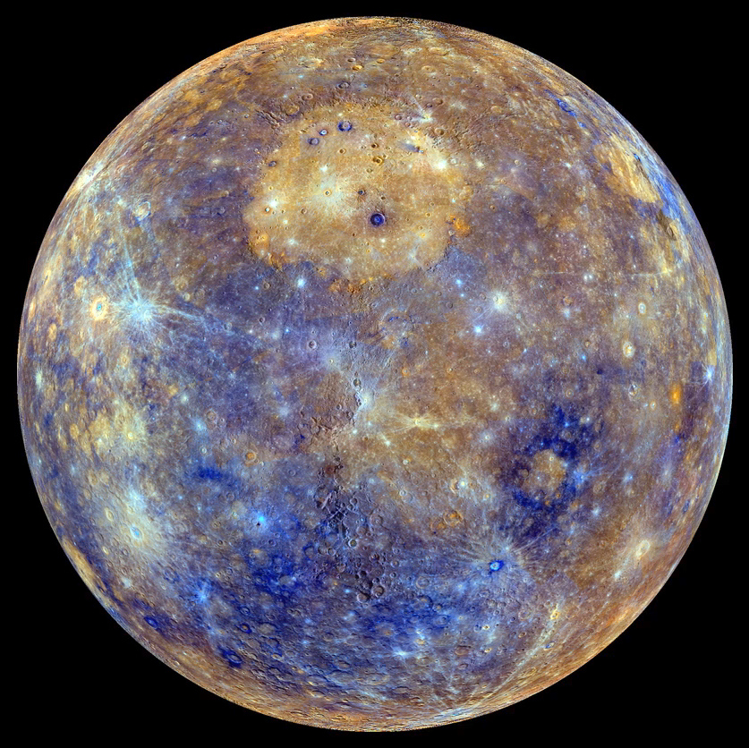
Mercury
Mercury is a celestial body that looks more like the Earth's moon and has craters on its surface caused by rock impacts. This planet is rocky and made of 70% iron ore, and other metals include nickel and dust.
The physical properties of Mercury include; Mass: 0.3302 x 1024 kg, volume: 6.083 x 1010 km, Average radius: 2439.7 km, Average diameter: 4879.4 km, Density: 5.427 g/cm3. Its velocity is 4.3 km/s and Surface gravity: 3.7 m/s2
Mercury is about 36 million miles from the Sun and an average distance of 48 million miles from the Earth (The Planets, 2019).
Mercury was discovered in the 17th century by Galilea Galileo and Thomas Harriot via observing using a telescope.
The most exciting fact is that Mercury can be seen with a naked eye, which brings an argument about the first person to discover it.
Notes:
Mercury is a celestial body that looks more like the Earth's moon and has craters on its surface caused by rock impacts. This planet is rocky and made of 70% iron ore, and other metals include nickel and dust. The physical properties of Mercury include; Mass: 0.3302 x 1024 kg, volume: 6.083 x 1010 km, Average radius: 2439.7 km, Average diameter: 4879.4 km, Density: 5.427 g/cm3. Its velocity is 4.3 km/s and Surface gravity: 3.7 m/s2. Mercury is about 36 million miles from the Sun and an average distance of 48 million miles from the Earth. Mercury was discovered in the 17th century by Galilea Galileo and Thomas Harriot via observing using a telescope (The Planets, 2019) The most interesting fact is that Mercury can be seen with a naked eye and this brings an argument about the first person to discover it. Some people feel that Galilea Galileo used the telescope to confirm its presence.

Slide 5
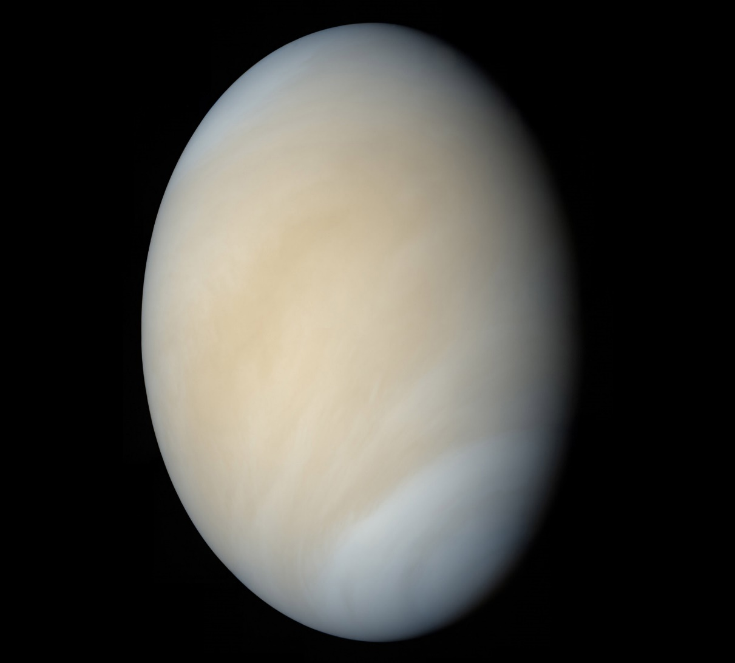
Venus
Venus is the second closest planet from the Sun. This planet is made up of a central iron core and a rocky mantle, and it has an atmosphere composed of 96% carbon dioxide, 3% nitrogen, and 1% other gases.
Venus has a density of 5.204 g/cm3, a gravity of 8.87 m/s2, and a diameter of 12,100 Km.
Venus is 108.59 million Km from the Sun and 43.17 million Km from the Earth.
In 1610, Galilea Galileo used a telescope and was able to observe this planet.
Venus is the brightest planet, and it appears yellow due to the thick carbon dioxide atmosphere and sulphuric acid clouds. Venus is poisonous due to a higher content of carbon dioxide in its atmosphere.
Notes:
Venus is the second closest planet from the Sun. This planet is made up of a central iron core and a rocky mantle, and it has an atmosphere composed of 96% carbon dioxide, 3% nitrogen, and 1% other gases. The atmosphere of this planet is close to that of the Earth. Venus has a density of 5.204 g/cm3, gravity of 8.87 m/s2 and a diameter of 12,100 Km, Venus is 108.59 million Km from the Sun and 43.17 million Km from the Earth (Batygin & Brown, 2016). In 1610, Galilea Galileo used a telescope and was able to observe this planet. Venus is the brightest planet, and it appears yellow due to the thick carbon dioxide atmosphere and sulphuric acid clouds. Venus is poisonous due to a higher carbon dioxide content in its atmosphere; this makes it capable of suffocating people, especially when it receives heat and light from the Sun.

Slide 6
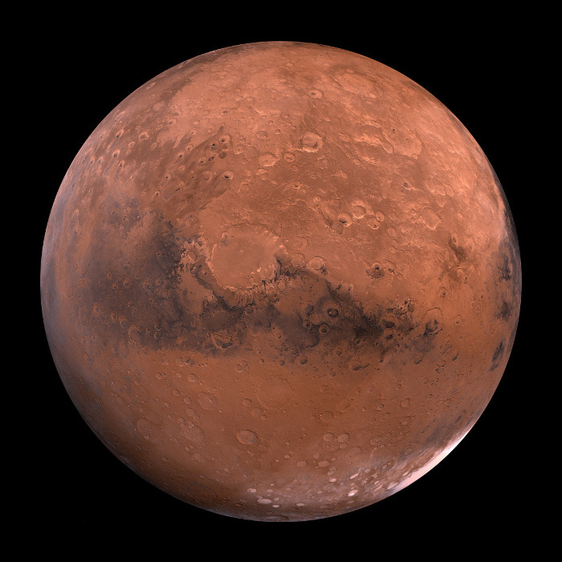
Mars
The main constituents of this celestial include and atmosphere made of 95.32 percent carbon dioxide, approximately 2.6 percent molecular nitrogen, and 1.9 percent argon. It has microscopic levels of water vapor, hydrogen, and oxygen. The planet has dark volcanic rock, and most of its surface is red.
Mars has a density of 3.9335 g/cm3, a gravity of 3.72076 m/s2, and a diameter of 6,779 km.
From the Earth, Mars is 149.32 million km and 211.74 million km from the Sun (Batygin & Brown, 2016).
Galileo was the first to view Mars in a telescope in the 17th century at around 1610, and he described it as a brighter disk. The planet visible without a telescope, and thus it is hard to name the exact person who discovered this planet.
The planet seems to have dried rivers and mountains with active volcanos. Mars has two smaller moons and have irregular shapes.
Notes:
The main constituents of this celestial include and atmosphere made of 95.32 percent carbon dioxide, approximately 2.6 percent molecular nitrogen, and 1.9 percent argon. It has minute levels of water vapor, hydrogen, and oxygen. The planet has dark volcanic rock, and most of its surface is red. Mars has a density of 3.9335 g/cm3, a gravity of 3.72076 m/s2, and a diameter of 6,779 km. From the Earth, Mars is 149.32 million km and 211.74 million km from the Sun. Galileo was the first person to view Mars in a telescope in the 17th century at around 1610, and he described it as a brighter disk (Batygin & Brown, 2016). The planet visible without a telescope, and thus it is hard to name the exact person who discovered this planet. The planet seems to have dried rivers and mountains with active volcanos. Mars has two smaller moons and have irregular shapes.

Slide 7
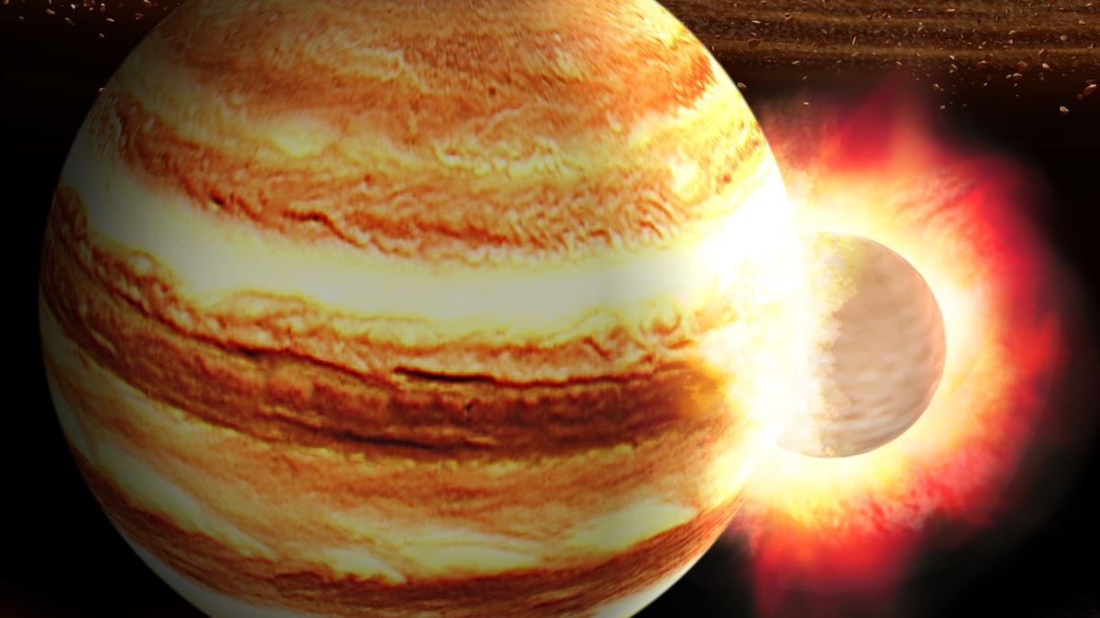
Jupiter
Jupiter has an atmosphere that can be liked to that of the Sun because it has higher amounts of hydrogen and helium gasses. The planet has thick red, brown, yellow, and white clouds, and these stripes appear as rings.
Jupiter's surface area is 61.42 billion km², a density of 1.326 g/cm3, a gravity of 24.79 m/s², and a diameter of 88,846 miles.
Jupiter is 774 million km from the Sun and 656.31 million km from the Earth.
According to Powers (2018), Jupiter was first observed via a telescope on January 2, 1610, by Galilea Galileo man observed four larger moons orbiting in this celestial.
Jupiter is the giant planet, and it is essential in the solar system in that it influenced the formation of all the other planets.
Notes:
Jupiter has an atmosphere that can be liked to that of the Sun in that it has higher amounts of hydrogen and helium gases. The planet has thick red, brown, yellow, and white clouds, and these rings appear as rings. The surface area of Jupiter is 61.42 billion km², a density of 1.326 g/cm3, a gravity of 24.79 m/s², and a diameter of 88,846 miles. Jupiter is 774 million km from the Sun and 656.31 million km from the Earth. Powers (2018), mentioned that Jupiter was first observed via a telescope on January 2, 1610, by Galilea Galileo man observed four larger moons orbiting in this celestial. Interestingly, Jupiter is the largest planet, and it is crucial in the solar system in that it influenced the formation of all the other planets. Living on the surface of Jupiter would be difficult though not impossible. The gas giant has a small rocky core with a mass ten times less than Earth's, but it's surrounded by dense liquid hydrogen extending to 90 percent of its diameter.

Slide 8
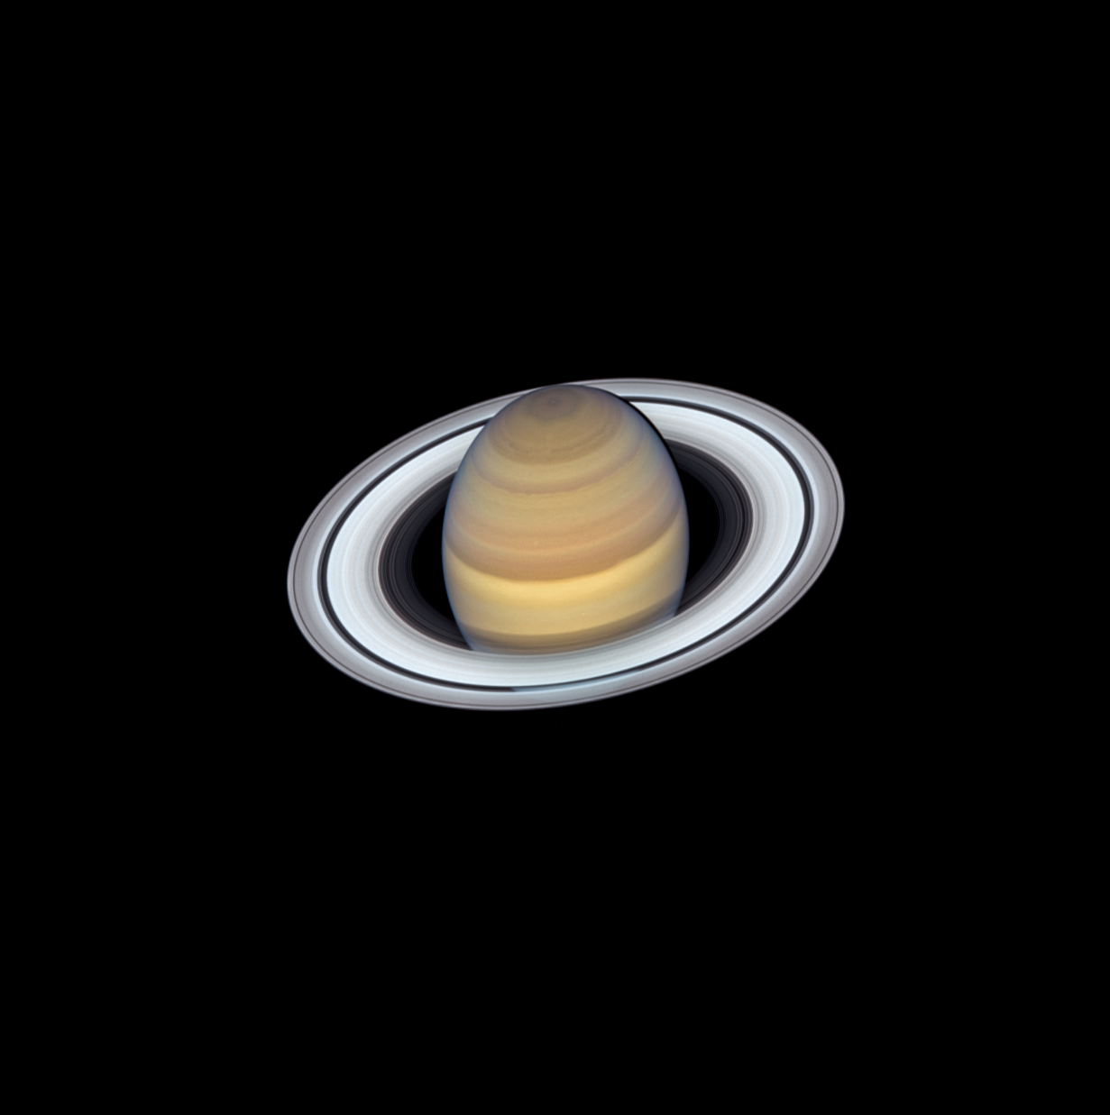
Saturn
The planet's surface is less solid than the Earth, but rather a giant gas planet. It's composed of 94% hydrogen, 6% helium, and traces of ammonia and methane. Astronauts think that there might be a molten, rocky core on the surface of this planet (Powers, 2018).
The planet has a density of 687 kg/m³, a gravity of 10.44 m/s², mass 5.683 × 10^26 kg and a diameter of 120,536 km. The planet has rings and is less dense (Zapata, 2017).
Saturn is 1.4957 billion km from the Sun and 1.3901 billion km from the Earth.
This planet is visible with naked eyes and thus was known in the pre-historic period. However, in 1610 Galileo Galilei made a good move and observed the planet under a telescope.
The first Astronauts thought that Saturn's rings were moons. The planet is the least dense of all the others in the Solar System.
Notes:
Saturn is the sixth planet from the Sun and has the giant rings. The surface of this planet is less solid as compared to the Earth, but rather a giant gas planet. It's composed of 94% hydrogen, 6% helium, and traces of ammonia and methane. Astronauts think that there might be the molten, rocky core on the surface of this planet. The planet has a density of 687 kg/m³, a gravity of 10.44 m/s², mass 5.683 × 10^26 kg and a diameter of 120,536 km. The planet has rings and is less dense. Saturn is 1.4957 billion kilometers from the Sun and 1.3901 billion kilometers from the Earth (Zapata, 2017). This planet is visible with naked eyes and thus was known in the pre-historic period. However, in 1610 Galileo Galilei made a good move and observed the planet under a telescope. The first Astronauts thought that Saturn's rings were moons, but it was later discovered that the planet has 62 moons and rings on its diameter. The planet is the least dense of all the others in the Solar System.

Slide 9
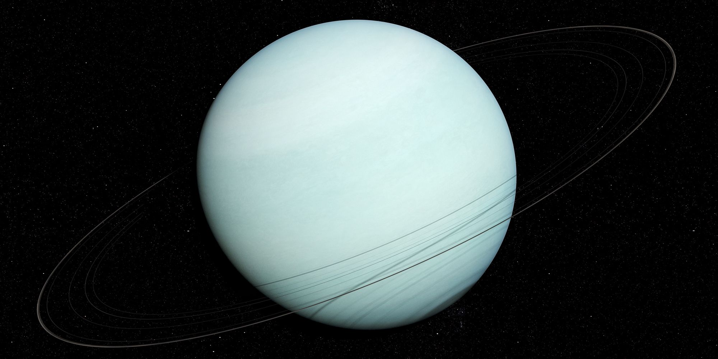
Uranus
Uranus is categorized under planets, and it is the seventh planet from the Sun. It has a set of 13 rings, and it is an ice giant. Above its solid core are icy materials.
The planet has a thick atmosphere made of 83% hydrogen, 15 % methane, and other gases.
The diameter of Uranus id 31,800 miles, four times larger than that of the Earth. The density is 1.27 grams per cubic centimeter, and thus, it is the second least dense planet. The gravity of this planet is 8.87 m/s² (Powers, 2018).
Uranus is currently 2.9619 billion km from the Sun and 3.0851 billion km from the Earth.
Uranus was discovered on March 13, 1781, by Sir William Herschel while he was scouring comets' night sky (Zapata, 2017).
Interestingly, Uranus is nick-named the bulls-eye planet reflecting on the nature of its rings, not horizontal but vertical, and thus it looks like a bull-eye on target large layers of rings.
Notes:
Uranus is categorized under planets, and it is the seventh planet from the Sun. It has a set of 13 rings, and it is an ice giant. Above its solid core are icy materials. The planet has a thick atmosphere made of 83% hydrogen, 15 % methane, and other gases. The diameter of Uranus id 31,800 miles, four times larger than that of the Earth. The density is 1.27 grams per cubic centimeter, and thus, it is the second least dense planet. The gravity of this planet is 8.87 m/s² (The Planets, 2019). Uranus is currently 2.9619 billion km from the Sun and 3.0851 billion km from the Earth. Uranus was discovered on March 13, 1781, by Sir William Herschel while he was scouring the night sky for comets. Interestingly, Uranus is nick-named the bulls-eye planet reflecting on the nature of its rings, not horizontal but vertical, and thus it looks like a bull-eye on target large layers of rings.

Slide 10
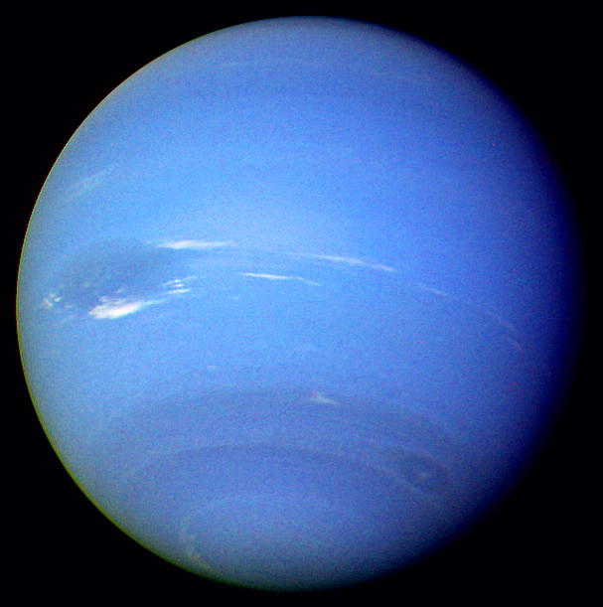
Neptune
Neptune is the ninth planet of the solar system. Similar to Uranus, Neptune is an icy planet. The atmosphere is made up of hydrogen, helium, and methane gas.
The rocky core consists of silicates and metal and a mantle made of water, ammonia, and methane.
Neptune has a gravity of 11.15 m/s², a density of 1.638 g/cm3, and a diameter of 49,244 km (Powers, 2018).
The planet is 4.4933 billion km from the Earth and 4.4767 billion km from the Sun.
Neptune was discovered on September 23, 1846, by Johann Gottfried Galle, Urbain Jean Joseph Le Verrier, and John Couch Adams, and all these mathematicians worked together.
There are a lot of theories following the discovery of this planet. In 1989, NASA sent its first spacecraft to observe planet Neptune using Voyager 2.
Notes:
Neptune is the ninth planet of the solar system. Similar to Uranus, Neptune is an icy planet. The atmosphere is made up of hydrogen, helium, and methane gas. The rocky core consists of silicates and metal and a mantle made of water, ammonia, and methane. Neptune has a gravity of 11.15 m/s², a density of 1.638 g/cm3, and a diameter of 49,244 km. The planet is 4.4933 billion km from the Earth and 4.4767 billion km from the Sun. Neptune was discovered on September 23, 1846, by Johann Gottfried Galle, Urbain Jean Joseph Le Verrier, and John Couch Adams, and all these mathematicians worked together (Powers, 2018). There are many theories following the discovery of this planet, and some link Galilea Galileo to its discovery. In 1989, NASA sent its first spacecraft to observe planet Neptune using Voyager 2.

Slide 11
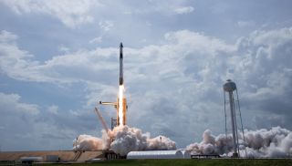
Conclusion
The knowledge of the solar system helps build concepts that can develop an understanding of the vast world beyond the Earth.
Space exploration is critical in addressing fundamental questions related to human place and the Universe.
Generally, the technology used for space exploration is costly, and thus NASA needs to be funded to facilitate all activities (Milman, 2016).
Human space exploration helps in safeguarding the borders of nations and thus leading to peace. Without finances, national security will be risked.
Understanding how the solar system was formed is essential for people across the world. This implies that additional finances will help in expanding human knowledge on the solar system.
Notes:
In summation, different celestials have different physical properties as elements of the solar system. The knowledge of the solar system helps build concepts that can develop an understanding of the vast world beyond the Earth. Space exploration is critical in addressing fundamental questions related to human place and the Universe. Generally, the technology used for space exploration is very expensive, and thus NASA needs to be funded to facilitate all activities (Milman, 2016). Human space exploration helps in safeguarding the borders of nations and thus leading to peace. Without finances, national security will be risked. Understanding how the solar system was formed is essential for people across the world. This implies that additional finances will help in expanding human knowledge on the solar system.

Slide 12
References
Batygin, K., & Brown, M. E. (2016). Evidence for a distant giant planet in the solar system. The Astronomical Journal, 151(2), 22.
Jesus-Rydin, C., Jones, B., Karsten, J. L., Jones, B., Scherer, L., Posselt, J., ... & Bell, R. E. (2018, December). Planets in the Milky Way: Their Occurrence and Their Characteristics. In AGU Fall Meeting Abstracts.
Milman, O. (2016). Trump to scrap NASA climate research in crackdown on ‘politicized science.’. The Guardian, 23(11).
Powers. J., (2018). The characteristics of the eight planets. Retrieved from https://sciencing.com/characteristics-eight-planets-8332488.html
The Planets, (2019). The Planets. Retrieved from https://theplanets.org/planets/
Zapata, E. (2017). The Opportunity in Commercial Approaches for Future NASA Deep Space Exploration Elements.

